Slide 1

National Priority ….
Talent Shortage of Career Ready Citizens to
Design and Build Things at Home,
Again!
Manufacturing AS A Desirable Career

Slide 2
Challenges Facing Education, Manufacturing & Economy
Education
Manufacturing
Economy
Only 38 percent of 12th graders read at grade level.
67 percent of all fourth graders scored "below proficient” in reading
School dropout rate is about 1.3 million a year
82 % of manufacturers have a shortage of skilled workers
600,000K skilled job openings are unfilled
2.7 million skilled workers likely to leave the labor force over the next 10 years
75% of products consumed is produced at home
Smart actions by business leaders, educators, and policy makers could raise it to 95%
What schools
are doing to become efficient at graduating career ready
citizens?
What manufactures
are doing to recruit, develop, and retain
a skilled
workforce?
What manufactures are doing to learn how to become more globally competitive
at home?
Best Practices
Best Practices
Best Practices

Slide 3

Talent Shortage of Literate Career Ready Citizens
AME International Conference Chicago October 2012
Community of Practice Findings
Parents, students, and educators need to be enlightened about manufacturing as a professional career which supports a higher standard of living.
Communities need to support an infrastructure based around the LEARN Act (Literacy Education for ALL Results for the Nation) in all 50 states.
Companies and learning organizations need to accept responsibility for helping schools and colleges produce literate career ready citizens.
Schools and colleges need to support the certification of teachers of reading and STEM (Science,Technology,Engineering,Mathematics) skills.
Reading and writing are the foundational skills without which
educational and economic attainment become
“unattainable”.

Slide 4
Career Readiness & 21st Century Learning
Requirements
Globalization and new technology requires a skilled work force
85 % of new jobs will be classifies as skilled jobs
Best Practices
A holistic approach to education with both the basic and applied skills
Germany students combine classroom and workplace learning with credentials
Rewards
Manufacturing workers receive 17% total higher compensation than others
A one-year occupational certificate may earn more than college degree

Slide 5



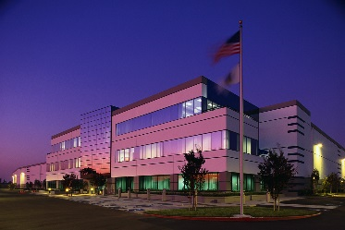

Roadmap for the 21st Century - Career Ready Citizens
Starting Life’s Journey
4th – 12th
Investing
in
Our
Future
Reading to Learn
Post High School
Excited about
Learning to
Read
Training &
Certified
Graduating
Career Ready
Citizens
Designing
Globally
Competitive
With
Highest
Standard of
Living
Cradle to Career
Skilled
Professionals &
College
Graduates

Slide 6
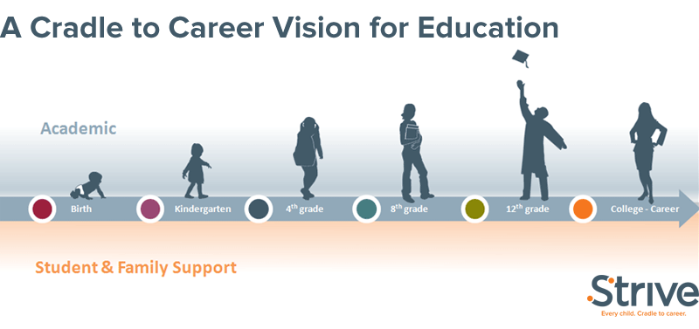
Roadmap for the 21st Century Career Ready Workforce
Career Pathways (Parents, Students, Educators)
Literate Nation (LEARN ACT)
STEM Skills (right courses)
            New Horizons Regional Education Centers
Society for Manufacturing (SME) Prime School Initiative
            American Productivity & Quality Center(APQC) North Star Program Manufacturing Institute - Skills Certification System
Veterans Programs
AME Regional Consortiums
AME/SME LEAN Certification
AME Manufacturing Excellence Award
MB State & National Awards
Life Long Learning For Individuals & Organizations

Slide 7
Actions for 21st Century Career Ready Citizens
Strategy to produce literate career ready citizens:
  Design a “cradle to a rewarding career” community roadmap
  Students need to be reading proficient by the end of 3rd grade
  Schools and businesses come together to offer the “right” courses
  Students receive skills credentials or college credits while in high schools
  Schools produce career ready citizens for the workforce and or college
  Manufacturing As A Desirable Career Path, Again!

Slide 8
Roadmap for the 21st Century Career Ready Workforce
Suppliers Input Process Output Customers
Student Enters Pre-K Program
Student Learns and Develops Skills
Student Assesses Career & Educational Pathways
Student Graduates / Completes
Student Continues Life-Long Learning
Parental Involvement
STEM Degrees &
Careers
Education Program
Inventory
Workforce Analytics
Federal
State
Targeted
Industries
Wage
Earners
Parents
Schools
Colleges
Organizations
Right Skills
Right Time
Right
Industries
Life Long Learning For Individuals & Organizations

Slide 9
Talent Supply Chain Metrics
Inputs to the Talent Supply Chain (Information) | Talent Development Process | Output Results from the Talent Development Process
Workforce Analytics (Occupation/Skill Supply & Demand Analysis) •Volunteer Hours per School •Usage Statistics for Program Inventory | •X% Increase in Voluntary Pre-K Enrollment •Career and Professional Education (CAPE) Academy Attendance Data (by Targeted Industry) •CAPE Academy Completion Data | The Right Skills •STEM Skills Tagged to Degrees Tagged to Universities •Remediation Costs to Industry •Remediation Costs to Universities
 |  | At the Right Time •Talent Supply Meets Industry Demand at Times of Growth •Continuing Education Investment by Industry
 |  | In the Right Industry •Customer Satisfaction Index Measurement
Student Metrics
 | STEM Graduates from CAPE Academies •STEM Graduates from Colleges and Universities | STEM Graduates Placed in Targeted Industries Within Six Months of Graduation/Completion •STEM Graduates Placed Within Six Months of Graduation/Completion
Talent Development Process
Output Results from the Talent Development Process

Slide 10
Manufacturing AS A Desirable Career Path
Team : Glenn Marshall, Doug Carlberg, Cheryl Jeckiel, Paul Kurchuris, Dale Gehring, Regional President (TBD), Janice Tobin, Keith Syberg, SME, APQC, Literate Nation, and others as identified
Final Revised Definition | Key Markets | 5 Year Vision | 3 Year Vision | Areas of Focus 2013 | Manufacturing Career Measures of Success | Resources
A Manufacturing Renaissance to get parents, students, and schools excited about careers in manufacturing to design and build of things at home, again and increasing the standard of living of all our citizens | Manufacturing - Transactional and Non-Transactional | School will produce "career ready citizens" excited about leading the designing and building things at home, again |  | Increase the awareness of the talent shortage of career ready citizens to fill needs of advanced manufacturers. Establish Career Portal for job offerings and related resources. | 1. AME portal will help students find jobs and resources for careers in manufacturing | Programming support for website and marketing to get the awareness of AME resources. National Press Conference announcing the initiative. With follow-on releases and articles
 | Schools, College Students and College Professors |  |  | Brand AME as leading the way to help academia provide right courses for students to be career ready for jobs in manufacturing. | 2a. AME website is top Google search for Career Ready Citizens for Manufacturing | Marketing, Social Media & Public Relations, PR Firm
 |  |  |  |  | 2b. Define current state of shortage of career ready talent. | Benchmarking
 |  |  |  |  | 2c. Identify at least one school district in each state that is engaged with AME " Manufacturing AS A Desirable Career Path" - Virginia is the first pilot followed by Texas | Regional Activity
 | Government - Military and VA | AME known for valuing veterans |  | AME will include government programs and initiatives to help veterans find employment as Lean Leaders | 3. Expand efforts of Virginia Values Veterans and get more AME members hiring veterans. AME APQC Webinar & Atlanta 2013 | Marketing, Social Media & Public Relations, PR Firm

Slide 11
Action Plan | Target to Improve | Owner | Last Year Results | 2013 | Jan | FEB | MAR | APR | MAY | JUN | JUL | AUG | SEP | OCT | NOV | DEC
Work with Scott S and Alliance partners to get the word out in news releases, media, newsletters, etc., | Increase the awareness of the talent shortage of career ready citizens to fill needs of advanced manufacturers. | Glenn |  | Plan |  | 9 |  |  | 18 | 19
 |  |  |  | Actual |  | 9
Identify with Alliance partners the available resources and add links to the MFG Career Portal | Establish Career Portal for job offerings and related resources | Paul |  | Plan |  | 9 |  | 15 | 18
 |  |  |  | Actual |  | 9 |  | 15
Identify those leading schools like SME Prime to help define the right STEM Skills and courses develop career ready citizens | Brand AME as leading the way to help academia provide right courses for students to be career ready for jobs in manufacturing. | Janice |  | Plan |  |  |  |  | 18 | 2
 |  |  |  | Actual
Build on veteran friendly initiatives and expand outreach to companies within AME | AME will include government programs and initiative to help veterans find employment as Lean Leaders | Doug |  | Plan |  |  |  | 15 | 18
 |  |  |  | Actual |  |  |  | 15
Community Consortium pilot for career ready citizens with focus on advanced manufacturing | Increase the number of students who get engaged in STEM subjects and courses with more manufactures involved with the schools | Glenn / Doug |  | Plan |  |  |  | 15 | 18 |  |  |  | 30
 |  |  |  | Actual |  |  |  | 15

Slide 12
AME Manufacturing Portal for Manufacturing Careers
Educational Operational Improvement | Student Involvement | Workforce Development
Tools Available APQC - North Star Program Baldrige Criteria for Excellence Teacher Development SME - Prime Program | Mfg. Talks Shipley Tools Trade Shows Innovation Contests | Skills Standards (Mfg. Institute) Veterans Programs Joe Barto & Badging E-Learning (SME) Job Board MI's Dream it - Do it

Slide 13
WELCOME TO DREAM IT. DO IT. VIRGINIA.
From making jets fly to creating life-saving medicine, careers in advanced technology such as manufacturing, health care, information technology, robotics, and biotechnology, offer above average pay, opportunities for advancement and skills that can be transferred across multiple industries.
Dream It. Do It. Virginia is a free career resource tool built by Virginia's advanced technology sector to help individuals learn more about exciting fields of possible future employment.
So what do you need to do to find out more about these careers? Access specific information along Virginia's advanced technology career pathway though the Explore, Ready, Train/Educate, Assess/Certify and Employ/Advance web pages.
http://www.themanufacturinginstitute.org/Image/Dream-It-Do-It/Dream-It-Do-It.aspx

Slide 14
Manufacturing AS A Desirable Career
Learning Organizations | Link to Resources / Best Practices | Benefits
Association for Mfg. Excellence | New Portal for Manufacturing Careers | Jobs & Resources
Virginia Manufacturers Assoc. | http://www.dreamitdoitvirginia.com/ | Job Profiles and Skills
Society of Manufacturing Engineers | http://jobsconnection.sme.org/home/index.cfm?site_id=123 | Job Openings
Society of Manufacturing Engineers | http://www.sme.org/workforce-development/ | Skills Credentials
Society of Manufacturing Engineers | http://www.smeef.org/programs/detail/prime | Schools Focus on Applied Skills
Manufacturing Institute | http://www.themanufacturinginstitute.org/Skills-Certification/Skills-Certification.aspx | Skills Certifications
Center for Quality People and Organizations | http://www.cqpo.org/edu_QUEST.php | PDCA in Schools and Communities
American Productivity & Quality Center | http://www.apqceducation.org/what-we-do/north-star-vision | Process and Performance Management for Schools
Literate Nation | http://www.literatenation.org/default.asp? | Reading to Learn
Career Pathways / STEMS Skills | http://sbo.nn.k12.va.us/careerpathways/nns/index.html | Business & School Partnerships
Gates Foundation | http://www.gatesfoundation.org/What-We-Do/US-Program/College-Ready-Education | Best Practices for Improving Education
Iseek | http://www.iseek.org/index.jsp | One Stop for Careers
Others

Slide 15
Blocker
Action Items Completed Last Month |  | Action Items Planned for this Month
1. Followed up with Alliance Partners to identify resources |  | 1. Refine team game plan and flush out short term actions.
2. Presented Career Ready Citizens concept and got community buy-in. |  | 2. Continue to build resource data base and establish specification for portal
3. Met with teachers of STEM courses to define how to get students and parents excited about manufacturing |  | 3. National Manufacturing Summit 19th June to focus on Manufacturing As A Desirable Career.
 |  | 4. Summer Edition of Target complete focus is on Manufacturing As A desirable Career
 |  | 5. Attend SME Gala to build on workforce development initiatives
Issues Encountered |  | Mitigation
1. Time & resources to push this initiative |  | 1. Align with partners to have them use PRIME Schools and other resources to accelerate deployment and get the word out manufacturing careers

Slide 16
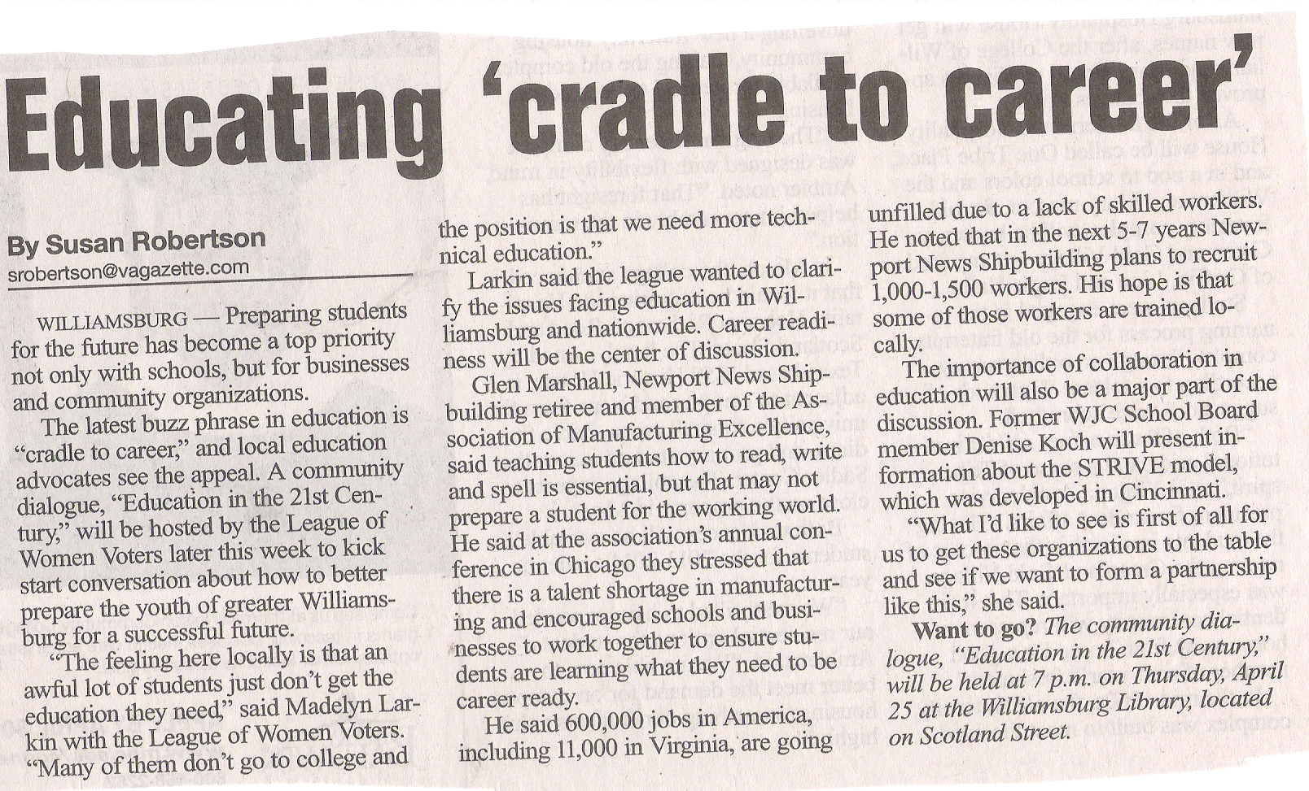
Talent Shortage of “Career Ready Citizens”
Virginia Gazette April 25th

Slide 17
Manufacturing As A Desirable Career Path
What we need ?
National PR campaign getting us know as leading A Manufacturing Renaissance
Staff to be brief and active promoting AME Leading A Manufacturing Renaissance.
Trifold to handout on Manufacturing Renaissance
Manufacturing Career Portal Designed and Deployed
National & Regional Boards Adopt a School District
Travel Budget to attend and present at national events – 15K?

Slide 18
Backup Materials

Slide 19
AME & Alliance Partners - Manufacturing Career Committee
Addressing Solutions by National Council For Advanced Manufacturing
Some 32 national manufacturing trade associations and professional societies have agreed to support America’s 21st Century Learning System policy road map recommendations developed by NACFAM members.
Building a Solution for America’s 21st Century Learning System
Establish a world-class learning system to enable U.S. students and workers to succeed in the 21st century global economy.
Promote and support appropriate, validated, and rigorous world-class learning standards, assessments, and curricula for U.S. students in grades Pre K-16.
Include applied learning in classroom teaching so students in grades Pre K-12 can see the relationship between what they learn in the classroom and what they do with this knowledge in the world of postsecondary education or work.
Require high school seniors to demonstrate a mastery of nationally-recognized academic and workplace competencies prior to graduation.
Require teachers in grades 7-14 to be credentialed in the subjects they teach.
Amend teacher certification regulations to permit the certification of expert private sector volunteers, retirees, and retired U.S. military members.
Provide federal financial incentives to the states to help them align their curricula, assessments, accountability systems, and teacher preparation and accreditation, and graduation requirements so they meet world-class learning standards.
Strengthen career counseling for students in grades 7-12 to help ensure that graduates gain access to postsecondary schools or productive employment.
Provide lifelong learning incentives to encourage all U.S. citizens to upgrade their knowledge and skills on a continuing basis so they can continue to work and be productive throughout their lives.

Slide 20
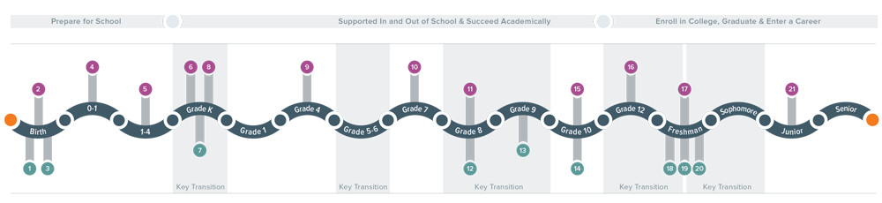
Cradle to Career Roadmap – Milestones
Birth
Has a stable relationship with parent/caregiver
Responds to parent/caregiver
Parent/Caregiver understands milestones
Kindergarten
Participates in high quality preschool
Exhibits learning skills (i.e. social competence)
Participates in full day kindergarten
Grades 8-9
Masters Algebra 1
Demonstrates social emotional competence
Engages in community & campus organizations
Freshman
Participates in freshman seminars
Has sufficient financial aid
Engages in community & campus organizations
Develops time & stress management skills
Ages 0-4
Uses exploration & discovery to understand surroundings
Develops letter knowledge & reading sensitivity
Grades 4-7
Reads at a 4th grade reading level
Has a clear expectation of charting a career path for joining the workforce or college
Grades 10-12
Develops a career plan & establishes goals
Passes at least 5, 9th grade courses with no failing grades
Masters advanced math & science with career ready skills
Career
21. Life Long Learning

Slide 21




Newport News Shipbuilding Career Pathways
Making Manufacturing COOL!
Awareness
  Self-awareness: individual uniqueness
  Connection between school and the world of work
Exploration
  Relationship between strengths/interest and courses, achievement, and career choices
  Career readiness skills, e.g., initiative, teamwork, problem-solving, work ethic, self-presentation
Preparation towards Opportunities
  Linkage between ethical behavior and the workplace
  Career Planning and workplace opportunities
Link to NNS Career Pathways
Notes:
Career Pathways expose students to grade-appropriate career development experiences. At the elementary level, students focus on AWARENESS; at the middle level the focus is on EXPLORATION; and in high school and beyond, Career Pathways works to create OPPORTUNITIES through activities, job shadowing, and hands-on training.
Beginning in elementary school, Career Pathways are an integral part of the K-12 learning experience for all Newport News public school students. Students enhance their career readiness skills and strengthen positive character traits. Students complete interest inventories that identify their strengths, interests and facilitate their selection of a Career Pathway in high school.
With Career Pathways, students connect with educators, parents, community members, and businesses to support their awareness, exploration, and understanding of the myriad career opportunities available. Career Pathways will help students enhance the link between the knowledge they acquire in school and the skills they need to pursue their dreams and fulfill the future workplace needs of the community.

Slide 22
Skills for a Career Ready Workforce
Basic Skills | Applied Skills
English Language (spoken) Reading Comprehension (in English) Writing in English (grammar, spelling, etc.) Mathematics Science Government/Economics Humanities/Arts Foreign Languages History/Geography | Critical Thinking/Problem Solving Oral Communications Written Communications Teamwork/Collaboration Diversity Information Technology Application Leadership Creativity/Innovation Lifelong Learning/Self Direction Professionalism/Work Ethic Ethics/Social Responsibility
Basic skills are important,
applied skills / sciences are a must for work place success.

Slide 23
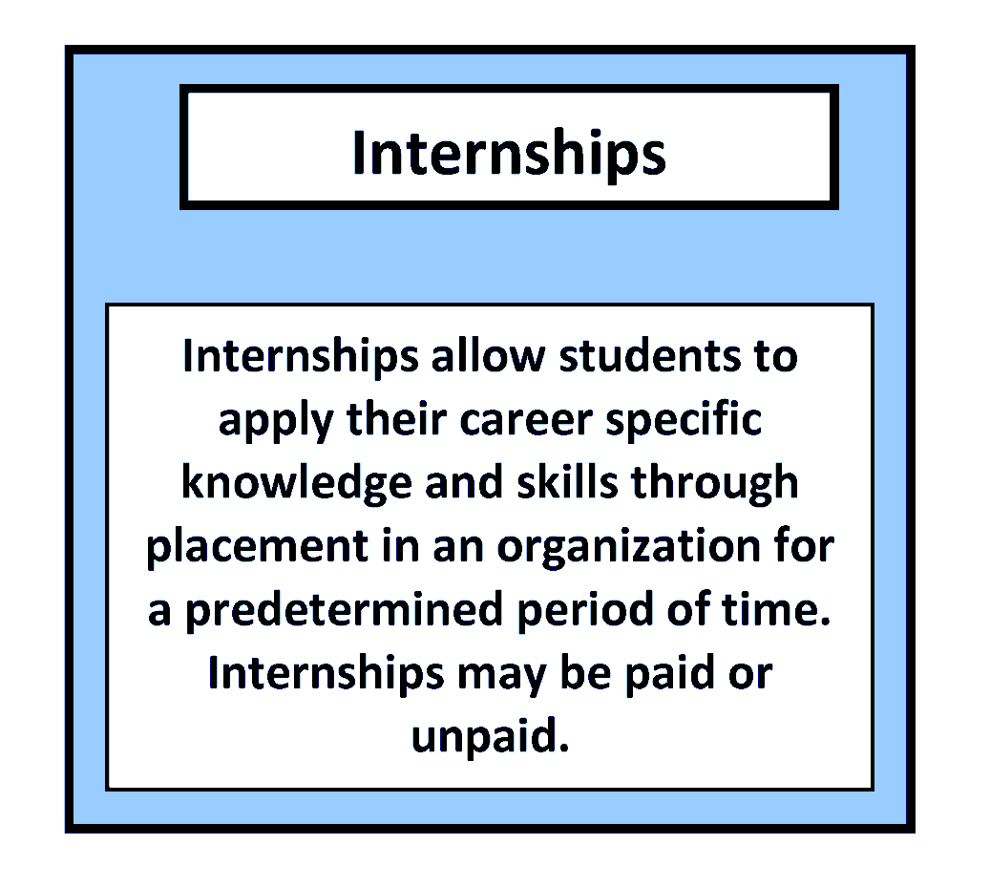
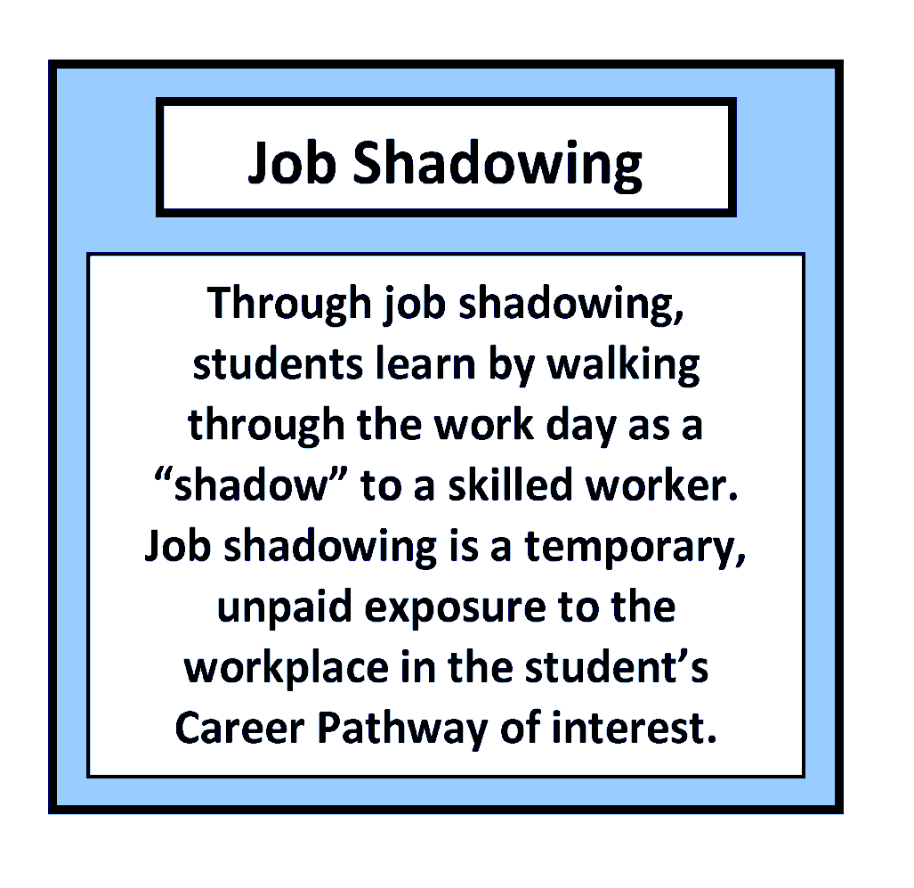
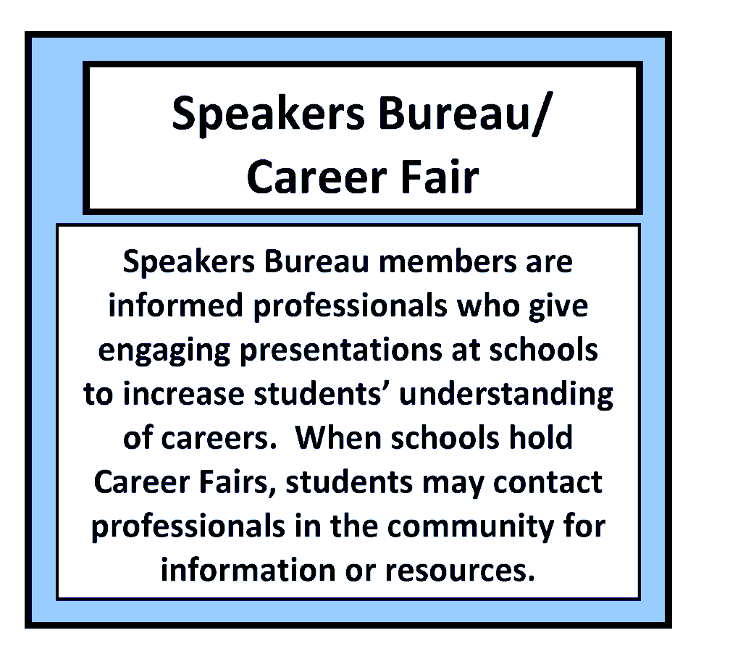
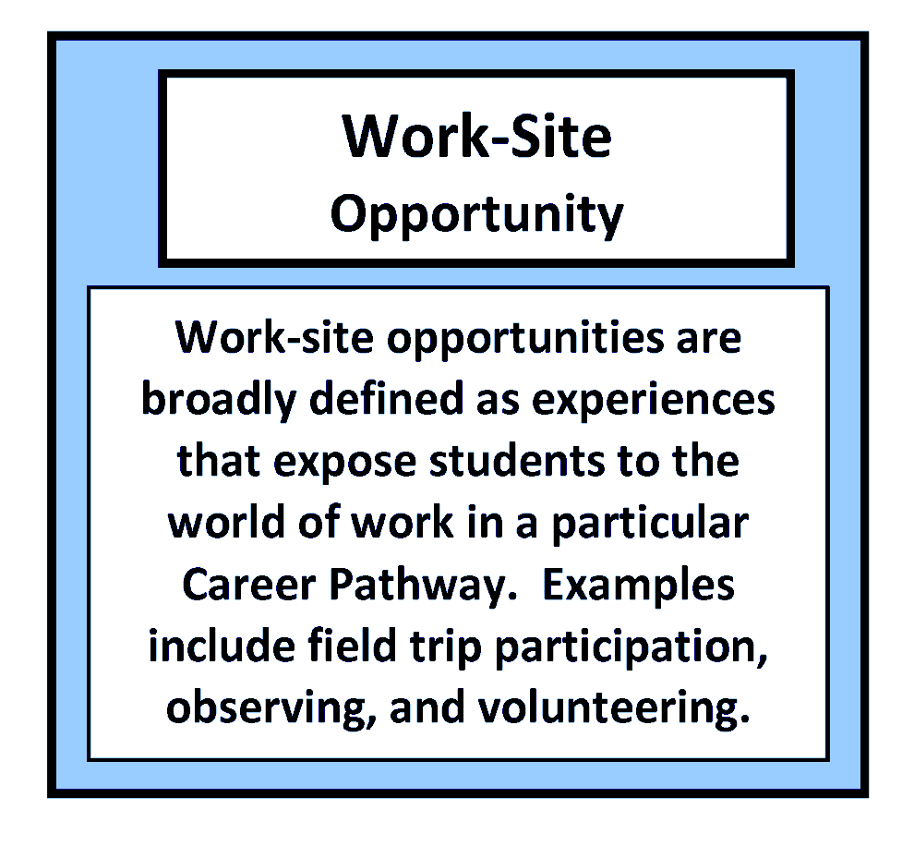
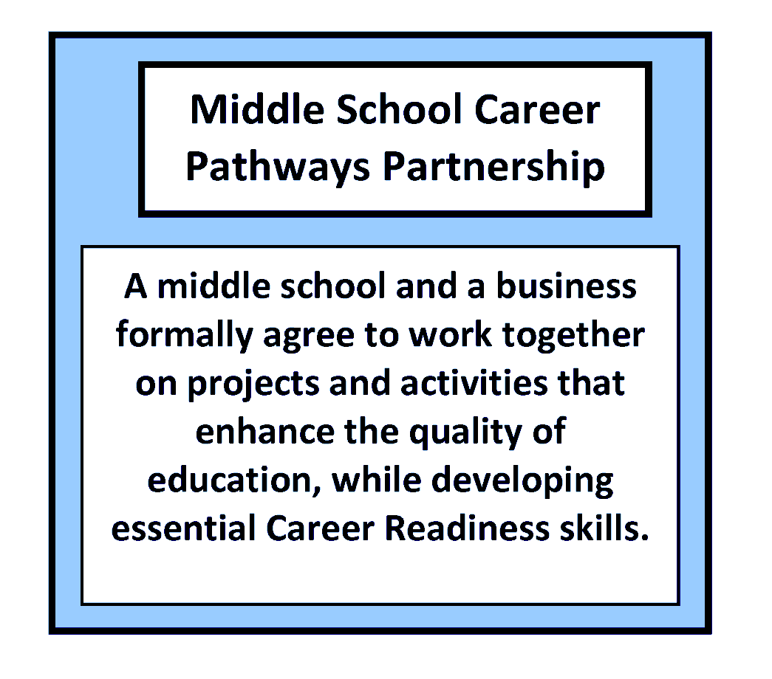

Career Pathways Initiatives
Career Pathways expose students to grade-appropriate career development experiences.
STEM SKILLS
Career Pathways at Newport News

Slide 24
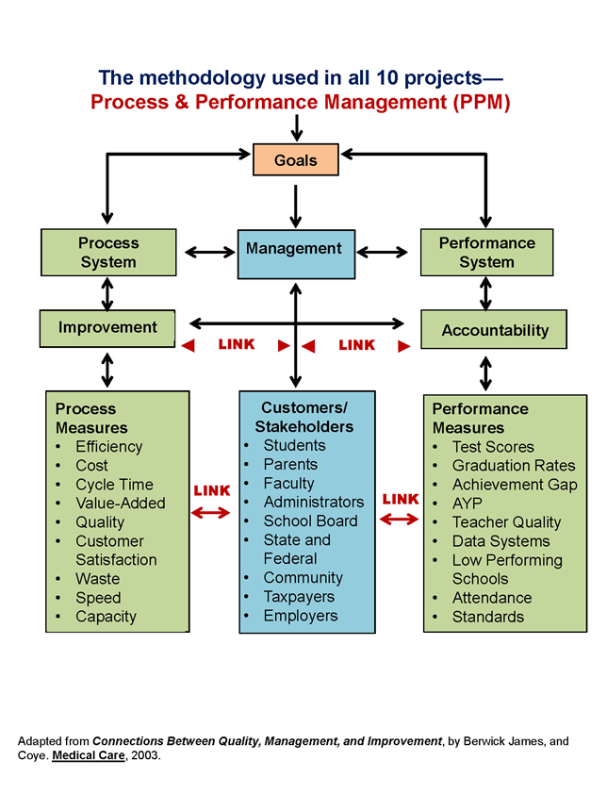

Slide 25
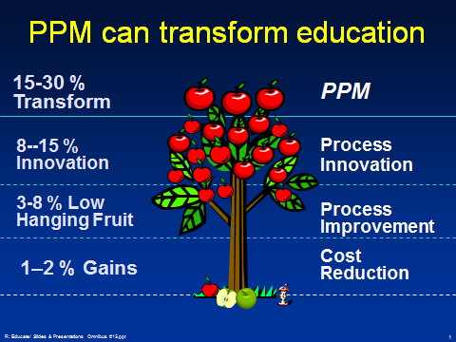

Slide 26
For Additional Information contact:
  Glenn Marshall
  Newport News Shipbuilding (retired)
  Association for Manufacturing Excellence
  marsh8279@aol.com
  757 585 1196
  www.ame.org
Thanks for Listening!

