Slide 1


Volume 1 / Issue 5 / February 2018/ Published quarterly by Richard Wiltse, AME Cleveland Consortium Facilitator
2018 Board Meeting
Thanks to all that attended the board meeting last month. Looking at the notes it becomes apparent that our consortia is alive and healthy! We are adding new members, coming out with more events, and collaboration is at an all time high.
Evidence of consortia health can also be seen in our upcoming benchmark of Akron Children’s Hospital, now in only the second week of advertising and we are almost sold out. There is very strong interest in the A3 workshop as well as a potential trip to Perry Nuclear Power plant - not to mention our trip this summer to Toyota. Our Minitab training session in January had roughly 20 people, and there is now pull for other workshops. What about our Special Interest Groups? We are continuing the ISO group, Lean Product Development, Toyota Kata and Shingo groups. There is interest in starting up SIGs on hoshin planning, senior management engagement, lean enterprise, and possibly an Ohno studies group.
As I have always stated, Consortia is what you make of it, and you, our members, are making the most of consortia. Participating, collaborating and getting to know your constituents.
Articles
Jan 2018 Board Meeting
General Consortia News
Norbert Majerus
Roundtables
Benchmarks
Consortia Business
Toyota Kata
Lean Product Development
Shingo
Workshops
New members
Member profile
Consortia schedule
Article
Pulling Lean
Richard Wiltse
216 548 7153 or email
rwiltse@tremcoinc.com
Page
1
2
2
3
4
3
3
4
4
5
6
7
8

Slide 2


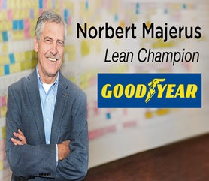
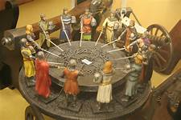
GENERAL CONSORTIA NEWS
Lean Survey
I have been working with Mike Crossen of Rockwell Automation, as well as other AME leaders, to develop a lean survey. The intent of the survey is to see how lean is being perceived by various groups such as senior managers, plant managers, CI practitioners, and others. My helper, Dave Chabut, has connected me to about 500 local people from these groups and they are slated to receive my pilot survey in February. A sampling of survey questions includes: How would you rate the effectiveness of your lean journey? Has lean met your expectations? Has your company reduced manufacturing lead-times, reduced FG or WIP inventory, and/or increased flow? Are lean improvements sustaining in your company? Do you feel lean is critical to the ongoing success of your company? Once I figure out if there are differences in the various groups, in particular senior management, it may drive a good roundtable discussion, or even a SIG group.
I’ll certainly be looking forward to hearing your take on the survey.
Norbert Majerus
On behalf of the AME Cleveland Consortium I would like to extend our congratulations to Norbert Majerus on his retirement from Goodyear. Norbert has stated that although he is retired from Goodyear, he is NOT (note the capital letters) retiring from lean. Norbert will be coming back to consortia on occasion to instruct workshops and hopefully to continue leading the Lean Product Development SIG. Again, congrats Norbert!
Roundtable sessions
We have been busy with our roundtable sessions. Last December we had Ned Hill present on “The Internet of Things (IoT)” at Preformed Line Products. Ned discussed how IoT will be affecting the manufacturing sector in the future, including the effect on the labor force and how connectivity will drive lean improvements. If you would still like a recording of this session, contact Doug Cozzens at Preformed Line Products.
We also had a Roundtable / SIG event on Shingo which was held at Rockwell Automation on January 31. Tim Pettry, a local Shingo assessor, gave up some of his time for a morning of question and answer. Feedback I got from the event was very positive. One of our newer members is even considering adopting the Shingo platform.

Slide 3


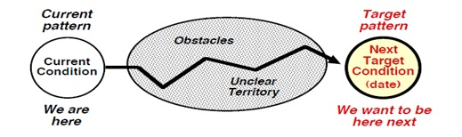
ROUNDTABLES….cont.
Given the success of our past several roundtable sessions, we are stepping up our game in the roundtable collaboration department. Some of the roundtable sessions I’m currently trying to schedule are knowledge transfer at Goodyear, lean wins consortia, front-line leadership and the war on waste, senior management engagement, and possibly a well known speaker on Kata. If you ever have an idea for a good roundtable session, please let me know.
BENCHMARKS
We have a number of consortia benchmarks planned for this year. We start off with a lean tour of Akron Children’s Hospital. We are then looking at an June timeframe for touring the Perry Nuclear Power Plant. In August we can will go to Georgetown Kentucky to tour a Toyota manufacturing plant, followed by a roundtable discussion with ex-Toyota executives. We then conclude with a trip to Honda R&D to review how they develop new cars.
SPECIAL INTEREST GROUPS
Toyota Kata
I recently took a trip to Wisconsin to join a “Kata Practitioners Day” hosted by Optima. In attendance were associates from Rockwell Automation, TIDI, Alliance Laundry Systems and Tremco.
I was very impressed with how some companies are driving Kata deep in their organizational cultures. Here is an example policy statement from TIDI:
TIDI Kata: Embed kata into our key systems as an ideal behavior to embrace scientific thinking. We want everyone in the organization to be skilled and engaged in improving their current condition towards a target condition that is aligned with our purpose and long term goals.
Kata as an ideal behavior with everyone working towards a target condition, now that’s management commitment.
The Kata presentations,which includes a presentation from Steve Jones, are uploaded to our G drive.
Our group includes Rockwell Automation, Tremco, Crown Equipment and Orbis.

Slide 4
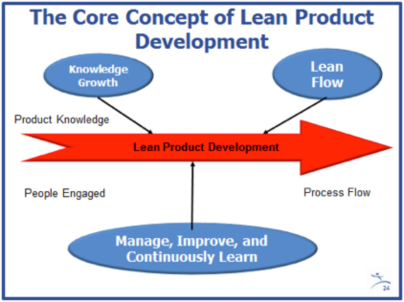
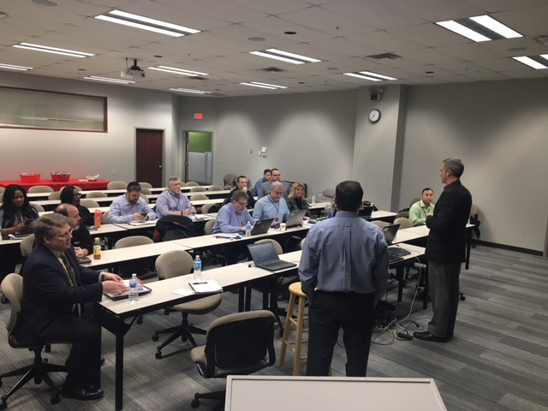
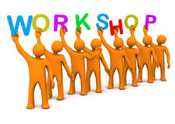
Lean Product Development
Another workshop is being prepared by Norbert, “1500 new products a year, on time, on target.” The workshop will be held this summer.
The group includes Goodyear, Rockwell Automation, Steris, Graftech, Honda R&D, and Kyocera-SGS Tool. Norbert Majerus of Goodyear is the team leader.
SHINGO
Sean Preatzel addresses the Shingo group in our Jan 31 panel session. Tim Pettry, a local Shingo assessor, and John Comi, Shingo practitioner, answered a barrage of questions ranging from why companies selected Shingo methods to expected benefits and how Shingo methods provide the basis for lean execution.
I admit this event was easy for me to facilitate – after a few opening questions the crowd took over and fired away.
The participating consortia companies include SSP, Davey Tree, Rockwell Automation, Tremco and Goodyear.
Workshops
In conjunction with our new member, Davey Tree, I’ll be offering up a value stream mapping workshop sometime in April. This is not our first rodeo relative to VSM, but if you have any new associates, or you simply want a refresher, send people down to Kent, Ohio for a one-day event. Also, on our past workshop agenda will be lean management, visual management, and down the road – Toyota Kata. All past workshops are free for Consortia members.
New workshops: A3 (April 5), People-centric Lean, 1500 new products on time and on target, and Lean Supply Chain.

Slide 5
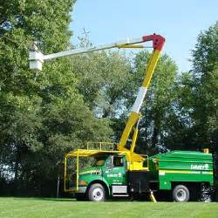
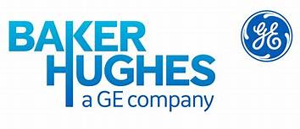
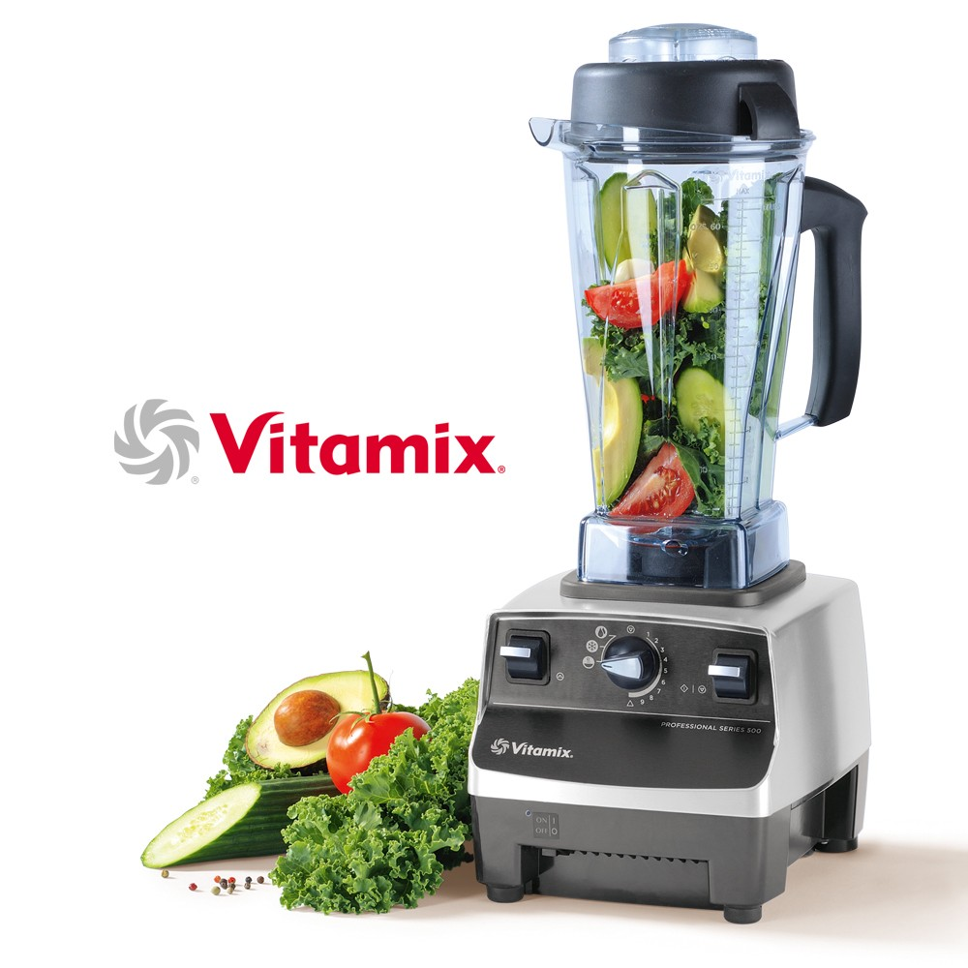
New Members
The Davey Tree Company
With operations throughout North America, Davey Tree is committed to scientifically-based horticultural and environmental services and outstanding client service. Davey Tree is Ohio’s largest employee-owned company and the fifteenth-largest in the nation, providing solutions that promote balance among people, progress and the environment. Its mission is to deliver unmatched excellence in client experience, employee strength, safety and financial sustainability as they advance the green industry.
Jason Brumbach is the consortia contact. Welcome Jason!
GE Baker Hughes
Baker Hughes, a GE company (NYSE:BHGE) is the world’s first and only full stream provider of integrated oilfield products, services and digital solutions. Drawing on a storied heritage of invention, BHGE harnesses the passion and experience of its people to enhance productivity across the oil and gas value chain. BHGE helps its customers acquire, transport and refine hydrocarbons more efficiently, productively and safely, with a smaller environmental footprint and at lower cost per barrel. Backed by the digital industrial strength of GE, the company deploys minds, machines and the cloud to break down silos and reduce waste and risk, applying breakthroughs from other industries to advance its own. With operations in over 120 countries, the company’s global scale, local know-how and commitment to service infuse over a century of experience with the spirit of a startup – inventing smarter ways to bring energy to the world.
Michael Claus is our consortia contact. Glad to have you Michael!
Vitamix
Makers and developers of the world’s best performing and most reliable blending solutions that are most trusted by professional chefs. Built with motors that are designed to last, Vitamix offers up a vast array of blenders and accessories. For over 70 years, Vitamix has provided these unique and high quality blenders that are built to be dependable, not disposable.
Sean Radigan is our primary contact. Welcome aboard Sean!

Slide 6
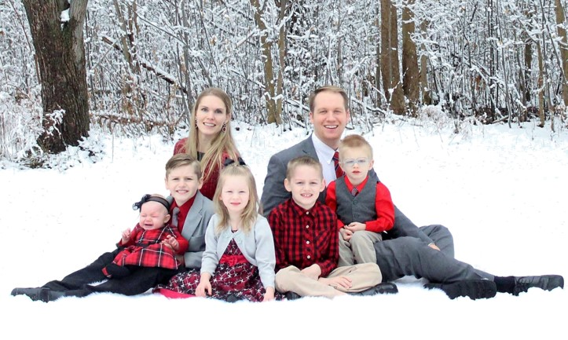
Member Profile: Chris Temple
Chris Temple is originally from Chelmsford, MA. “It’s a small town about 40 minutes north of Boston, 15 minutes from the Massachusetts / New Hampshire border,” said Temple.
Temple’s academic background includes a bachelor’s degree in Manufacturing engineering from Brigham Young University in 2011, while maintaining a full time job.
Temple’s tenure in learn:
“I first discovered lean working as material handler in an industrial valve manufacturing company during college,” said Temple. “I worked full time and attended BYU full time. The company was wanting to implement an off the shelf automated backflushing technology. I did not think it was a good idea so without prompting I performed several time studies, process maps (all before I had discovered lean!) and submitted a report to the GM of the site showing the amount of unnecessary waste the change was going to create. They scrapped the project based on my findings. It was at that point that an engineer pulled me aside and told me about Lean and the Manufacturing Engineering program at BYU. So, I have been a CI practitioner for a very long time, I just didn’t have a name for it. In my professional life I have always been in OPS roles where I was a very CI minded OPS person, or I have been in CI roles where I have been a very OPS minded CI person.”
Temple’s fondest lean achievement:
“Probably when I was the operations leader in Brazil. I had all of the department leaders (R&D, Engineering, Operations, Quality, Logistics, HR) reporting to me, so we were really able to break down any barriers and deploy lean across the whole organization.” Some accomplishments in the less than two years I was down there were:
▪ 75% reduction in safety recordables
▪ Improvement of On-Time-Delivery from 74% to 98%.
▪ 25% of the total square footage freed up
▪ 52% reduction of monthly customer complaints.
▪ Improvement of product gross margin from 17% to 38%.
▪ Production lead time from 45 to 15 days.
▪ One idea implemented per employee per week”
A family man, Temple has been married to wife Krista for 11 years. From meeting each other to marrying each other was 7 months. They have five kids: Gawyn (9), Ely (8), Acadia (5), Kyler (3) and Emily (8 months). They live in Chardon on five acres where they make our own maple syrup each year and are working on transforming their land into a horse property.
Hobbies include playing basketball 2-3 times a week and (brace yourself) applying lean at home and writing articles about it!
Looking good Chris!

Slide 7
AME Cleveland Lean Consortia:
2018 Schedule as of Feb 19th

Slide 8
Pulling lean – Richard Wiltse
Having trouble with resistance to lean? Try putting your lean practice on a pull system!
If you are a CI practitioner, you know the meaning of pull. When pulling, we use only what we need, when we need it. We study a production system and learn the bottlenecks and how material and information flow. We then pull the raw materials and information - what we need, when we need it. This eliminates overproduction, reduces WIP inventory, cuts waste, and creates flow.
This is in contrast to push where we make inventory, or plan a service, in accordance with the forecast or historical figures. Push has the effect of inflating both finished goods inventories as well as work in progress inventory. Ohm’s Law tells us that inflated inventories will greatly extend manufacturing or even service lead times.
So – let’s apply the concept of “pull” to the practice of lean itself. What is pulling lean? Simple, apply lean where you need lean, use only the tools that you need when you need them, train as you go, and drive towards achievable output metrics. End the practice of pushing lean on an area because you think it’s the right thing to do. Why? Because pushing lean is not people-centric. By nature, lean does not easily resonate with most people. You will face more resistance at all levels of the organization. You will also face more entropy while trying to sustain.
Think about it, most of the time we pick an area that we want to lean out – do a 5S event, implement some standard work start up tier meetings, visual boards, etc. Many of these efforts require significant change, often un-wanted. How do we handle explaining this change? Here is an example conversation:
Leader: “We need to be lean. We will be more flexible to meet demands. We will carry less inventory. Free up cash! Material will flow better, quality enhanced. Smaller batch sizes will require more set ups, but we will figure that out.”
Workforce response: “This machine only runs 2 – 3 days a week. We are meeting demand. The company is making money. Why are you asking me to be lean? You’re asking me to do more with less.”
Of course, there may be viable reasons for practicing lean on a machine that is at 50 percent demand capacity – such as freeing up resources or projected seasonal demand, but from the workforce perspective the work is getting completed faster in order to shut down sooner. How does our leader create pull? By explaining the rational for lean, linking the lean effort to a business need, and visualizing lean results with an output metric that makes sense to everyone.
Pulling lean is all about practicing lean where lean is needed, when needed, in accordance with a business strategy. Another example would be would be a capacity constrained machine that supports a strategic value stream. The compelling case for lean here is that you stand to lose customers if demand exceeds capacity - on a value stream that is critical to success. Most reasonable people will understand this rational. Now you have the mandate, the burning platform, to make change - that’s people-centric.
Let’s go one step further. For example, you’re implementing kata to relieve the above capacity constraint. Observing the process, you see variance in change-over times due to either methods or training. What a great case for standard work! By showing people your data, including how change may affect capacity, you are more likely to create buy in and acceptance for change. This is opposed to pushing standard work on someone for the sake of standard work. “Standardization has great benefits,” you tell your people. Guess what? Without the proper platform, there are people that will see this as a condescending degraded view of their abilities.
Do your homework – get the data, create a case for change, practice lean towards an output metric Get some results. You will have more buy in from folks, including senior management. Then listen as people start “pulling” for more.
More to come. Your thoughts are welcome !
Rick

