Slide 1
Volume 1 / Issue 4 / November 2017 / Published quarterly by Richard Wiltse, AME Cleveland Consortium Facilitator
AME Boston 2017
Well, another AME conference has come and gone. I can honestly state that this year’s conference was one of the best. I thought the keynote speakers were simply fantastic! The feedback I got from other people echoed my thoughts exactly.
What a learning experience. Aside from confirming that much of what we are doing at Tremco is on the right track, I brought back with me some really breakthrough approaches to implementing lean, such as seeing a company’s operators so engaged they used their own cell phones to video small improvements, then uploaded them to a single archive.
As you know, the AME annual conference is a great place to network, I did my best to network as well. In my case I used the AME conference to hook up with other Consortia practitioners to see what they are doing to enhance value for their members. I discovered some pretty interesting techniques, including use of social media to drive membership. See page 2 for more details.
Net year’s conference will be in San Diego, Oct. 29 – Nov. 1. I don’t have to tell you what the weather is like out there ☺. Let’s plan this event early and maybe include a Consortia night on the town!
Articles AME Boston 2017 General Consortia News Return on People / Lean Sensei
Benchmarks
Roundtables
Consortia Business Special Interest Group Review
Toyota Kata
Lean Product Development
Quality Metrics
Shingo
Workshops
Kaizen Corner
President’s Kaizen at STERIS
Article
Back to Basics
Richard Wiltse 216 548 7153 or email rwiltse@tremcoinc.com
Page 1 2 2 3 3
3
3 4
4
5
5
7

Slide 2
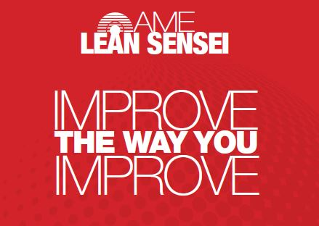
GENERAL CONSORTIA NEWS
Driving membership
As mentioned in the AME Boston 2017 section on page one, I met with other Consortia directors in an attempt to learn how to promote membership and drive value for members. Out of these discussions came insights that are interesting and thought provoking. One of the ideas generated focused on using social media to drive consortia membership.
A friend of mine, Joe Rizzo, runs a consortia in Maine. Joe is doing a stellar job of getting companies into consortia by posting articles on LinkedIn and always leaving his contact information in the article. For example, he will post an article on waste identification, adding “safety” to a 5S program, or even post up what consortia is all about. The point is that Joe is getting his consortia out there, in front of the world, and he is getting results – several new companies signed on in only six months/
So how about this? Send me an article of something your working on. Maybe you have a statement to make on Lean Enterprise, Lean Product Development, Kata, or simply waste removal. I’ll send it to AME to have it posted on LinkedIn.
Lean Sensei and “Return on People” metric
I received an e-mail from George Saiz, president of AME, relative to the Lean Sensei app and “Return on People”. If you’re anything like me, your first inclination is to wonder “what is that all about?”
Well, it turns out that other AME member companies are looking into a metric similar to ROI, but people-centric.This metric apparently looks at profit per employee, but in a people-centric way. In the coming days and weeks I will be speaking with Anne Graham of the Canadian regional board to find out exactly how this metric works and what other companies are doing with it. Relative to Lean Sensei, our hope is to implement the ROP metric (on a pilot basis) at a few Consortia companies, and then use the Lean Sensei app to determine if there is a correlation between ROP and Lean Sensei scores.
The ROP is very much a pilot program at AME. By participating in this endeavor your company will have an opportunity to be out front on development of what could be a key future metric in implementing Lean. In particular, our Quality / Lean Metrics SIG may have a keen interest in this activity. Please let me know if you are interested and I’ll get the ball rolling.
Richard Wiltse

Slide 3
BENCHMARKS
We had a fantastic benchmarking session at Orbis last September. What I liked the most is how Orbis engaged everyone, including top management, in the idea/suggestion system. The ideas were posted with a picture of the idea submitter. At Orbis continuous improvement is “Every Plant, Every Employee, Every Day.” If you missed this great benchmarking session, please go to the presentation on our Google site.
School Specialties: Due to seasonal fluctuations in its business, the next benchmark session at School Specialties has been postponed until 2018.
ROUNDTABLES
The next roundtable session is slated for December 8 at Preformed Line Products from 9:00 a.m. to 11:00 a.m. Ned Hill, Professor at The Ohio State University will discuss The digitally integrated manufacturing enterprise: Going beyond the labels of industry 4.0 and the Internet of Things. In this presentation, Hill will discuss the reality around the digitally connected manufacturing enterprise, how it will change productivity, supply chains, and the structure of work inside factories. Let me know ASAP if you can attend. Consortia members are free.
SPECIAL INTEREST GROUPS
Toyota Kata
On August 30, the Kata SIG group went to New Bremen, Ohio to view Crown’s Kata program.
It was very interesting to see the level of engagement in Kata at Crown. Kata has spread to many of the various manufacturing departments, including the refurbishment department. This is where Crown takes in old, beat up forklifts and makes them brand new again. Even in this environment, kata has seemed to improve flow and eliminate waste.
Another interesting twist to the Crown Kata program is that some of the applications of Kata did not appear to have a specific vision. The target condition was simply to eliminate the problem.
Next up is a trip to Milwaukee to see Rockwell Automation’s Kata program. There is a rumor of a “Kata Practitioner Day” around that time – I hope the team can make that event as well.
Our group includes Rockwell Automation, Tremco, Crown Equipment, Nelson Fasteners, and Orbis.

Slide 4
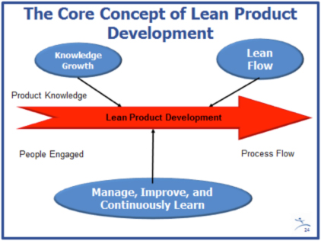
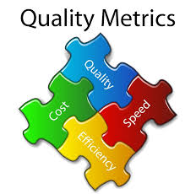
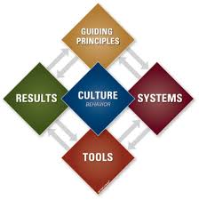
Lean Product Development
A workshop was held at STERIS on October 5, with Norbert Majerus. What I really liked was not only the number of people, but the fact that consortia could offer up a free workshop as part of the ROI on consortia. Thank you to Norbert for presenting his workshop to the AME Cleveland Consortium again.
The group includes Goodyear, Rockwell Automation, Steris, Graftech, Honda R&D, and Kyocera-SGS Tool. Norbert Majerus of Goodyear is the team leader.
QUALITY METRICS
The Quality Metrics group has met on several occasions recently to discuss OEE and Scrap metrics. The group is getting to hear how others are using these metrics to improve behavior. I thought it most interesting on how other companies beside my own are struggling with OEE.
The next meeting will be on December 13 at Lincoln Electric. I will present how Tremco blends KPI’s with our Strategic Hoshin Planning and the associated metrics.
The companies in this group consist of Rockwell Automation, Qualtech, Preform Line Products, Lincoln Electric, School Specialties, Honda R&D, KSGS and SSP. Alex Kuchik of Lincoln Electric is the team leader.
SHINGO
The next meeting for the Shingo SIG will be on November 27 at Rockwell Automation from 2:00 p.m. to 4:00 p.m. Several local Shingo assessor’s will participate in a panel discussion focused on implementing Shingo from the assessor’s perspective.
This is a rare occasion to really get into the grassroots of what Shingo is all about. Even if you are just curious, come and join us for what will be a very enlightening dialogue.
The participating consortia companies include SSP, Steris, Rockwell Automation, Nelson Fasteners, Goodyear and MTD.

Slide 5
Workshops
As workshops are a vital part of consortia membership, I plan to initiate a number of workshops in the near future. New workshops will include topics on facilitation, the ins and outs of kanban, lean supply chain, and A3 reporting. We may also look at a managing for daily improvement workshop.
In order to keep your associates on the learning path, I am offering old workshops as well. These include value stream mapping, visual management, a one-day course on kata, lean management, and lean in the office. Finally, I will be starting a Minitab statistics course in early December – free for all Consortia members.
I’ll be communicating with you in the near future to gage interest levels. We can of course review at the next Board meeting in January.
Kaizen Corner
President’s Kaizen at STERIS - Chris Temple
During the week of July 10, 2017, the STERIS Mentor Campus hosted the 2nd annual President’s Kaizen. The President’s Kaizen is a weeklong event targeting the top 300 executives of STERIS. In an effort to prepare the executives to participate in the President’s Kaizen event , executives went through a specialized week-long training program called Lean Leader Boot Camp. This program was focused on teaching basic Lean tools and principles as well as ideal leadership behaviors. Shortly after attending Lean Leader Boot Camp, these same executives participated in the President’s Kaizen. “The purpose of our President’s Kaizens is to take the executives and give them the opportunity to apply in a real world setting the tools and the principles that we teach in the Lean Leader Boot Camp” Herb Brown, VP of Lean Enterprise explains. He continues, “So the output of a President’s Kaizen is not just the improvement that we make to the process that we targeted, although those improvements are significant, but it’s also the introduction of a new wave of senior leaders into the organization. Leaders that are aware of the behaviors that are required of a lean leader…and are confident in their ability to drive change throughout our business.”
US Endoscopy hosted one of the five kaizen events occurring during the President’s Kaizen. US Endoscopy’s event was focused on improving the assembly of Platinum Roth by transitioning it from batch production to single piece flow. The improvement targets for the event were: 50% Productivity improvement, 50% Work in Process (WIP) improvement and Lead Time reduction from 3 days to 1 day. Kaizen member Jim Mooney, VP of Business Development said in describing his first impressions of the targets, “my first impression of those objectives was ‘Wow! These objectives are pretty stretch goals’ [but] as we have started to dig into the process and started to identify the different areas of waste, what has surprised me is we have actually come up with more ideas than we can physically accommodate in the space we are working in. It hasn’t been a process of struggling for ideas, it’s really been a process of prioritizing the best ideas.”

Slide 6
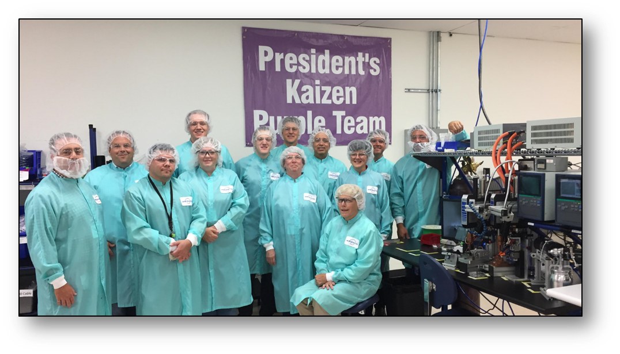
Kaizen Corner
The week consisted of the team documenting current state and familiarizing themselves with every aspect of the process. Through focusing on waste and distinguishing between value added and non-value-added activity the team identified many opportunities for improvement which ultimately resulted in a completed transformed process. The team implemented 14 safety improvements and 34 improvement ideas which in the end yielded some truly amazing results:
3-Person Single Piece Flow Cell
100% Productivity Improvement
Floorspace reduction from 2,080 to 184 sqft.
WIP Reduction from 1,485 to 3 pieces
Leadtime reduction from 4,320 to 8 minutes
Changeover from 19 to 9 minutes
Distance traveled from 386 to 38 ft.
With such stellar results, the team totally exceeded what was previously believed to be stretch goals. Not only did the team have great results, but they had fun doing it too! “I’ve really enjoyed working with everybody. They have been super helpful if I didn’t understand something, they were more than willing to help me understand and if they didn’t understand I felt more than comfortable in explaining to them what the process was.” Karen King, Precision Assembler I stated.
At the end of the week the team presented their results to the other four teams participating in the President’s Kaizen along with Walt Rosebrough, President and CEO and other members of the senior management team. Afterwards, individuals were given the opportunity to tour all the kaizen sites and see the results with their own eyes. Discussing the role lean has played at US Endoscopy and the experience of the President’s Kaizen, Tony Siracusa, VP and GM of US Endoscopy commented, “The lean journey at US Endoscopy has been a key part of our growth strategy as we strive to eliminate waste while we open space and free up resources to build more new products. It was great to bring in the additional resources into the President’s kaizen event and share what we have learned over time with other leaders at STERIS.”
Tony Siracusa, Bill Busby, Ed Pisarczyk, Linda Nicholson, Chris Temple, Matt Carroll, Karen King, Matt Stupica, Luis Flores, Lori Schneider, Harisa Hadzic, Jim Mooney, Mike Simenc,

Slide 7
Back to Basics – Richard Wiltse
Ask any football coach about a winning philosophy and most of the time you will here something like “we need to execute on the basics – blocking and tackling!” At a recent sales conference, my company brought in an ex-NFL lineman motivational speaker to discuss his model for long term career success. His career lasted 15 years in the NFL, an extraordinarily long career for a lineman. His daily routine consisted of practicing the basics – how to hike a football and block - every day during the wee hours of the morning. Every day, every morning, period, no exceptions, no excuses.
How do we apply this logic to implementing lean? Often times we want to run out and try the latest lean breakthroughs at our place of employment to try to “move the needle” again. Or, we get consumed in our most recent kaizen. Maybe we are busy trying to execute on a tactical Hoshin plan. Given these scenarios, it’s easy to overlook the basics.
So what are the basics? I suppose you could make an argument that the basicscould be summed up as 5S or standard work? The argument being that a workplace must be cleaned up and organized, with concrete standards in place, only then can true improvement can be made. I can kind of buy that, makes sense – but there exists another component. But first let’s hear what others had to say.
My recent survey of consortia members has turned up some interesting comments. Many of our expert practitioners have suggested that getting back to basics should focus on everything from constraint reduction, process balancing, visualization of the factory, and empowerment. I don’t doubt that many of these tactics are vital to your lean program. But are they the basics, something you will get up and do everyday, something that provides your daily platform?
I ask “What about the basics of people?” An often overlooked basic principle is what AME refers to as people-centric lean, where everyone, every day is pursuing process excellence. I believe that the basics of lean are getting in touch with your people, know what they do, listen, and building trust. Watch, learn, get their input, understand the process and the current state. After you feel you have a comprehensive understanding of the process and the ever so important people that are part of the process, then march forward. Do your PDCAs, 5S events, line balancing, and more.
My argument is that the basics of lean is people-centric and starts with you, the CI leader. I believe you enable the right culture by leading with humility, knowing your people, and knowing the process. I challenge you to look at your own Leader standard work and make a checkoff box that looks something like this:
Back to Basics
Listen to three operators today about how things are going
Learn something new about each process every day
Don’t just talk – address concerns. By doing this you will gradually build up your trust bank account, and also your knowledge of the process. You build your own value as well.
So, get back to basics. Try this everyday for two weeks, then maybe discover other people-centric basics that are the underlying support structure for lean. Don’t lose sight of team accomplishments and collective gains, discuss them with your people.
Then go out and call a “trips 32 double wing left on 3” west coast offense play, and score a lean touchdown.

